Slide 1
Local Government Week
October 21-25, 2024
Notes:
This week, the TDSB along with our partners at the Ontario Public School Boards’ Association (OPSBA), is working to raise civic awareness among our students by observing Local Government Week.
School board trustees are the oldest form of elected representation in Ontario. Since 1807, generations of community-minded citizens have made decisions on behalf of local, publicly funded schools, building the foundation of our system today.

Slide 2
Territorial Land Acknowledgement
Notes:
In 2017/18, the Urban Indigenous Community Advisory Committee of the Toronto District School, a group of Elders, Indigenous parents/guardians, and staff undertook a review of the Treaty Acknowledgement in consultation with TDSB staff and students, as well as Indigenous partners and Nations. Through this review, the Urban Indigenous Education Centre determined the official form of the TDSB Land Acknowledgement. At the TDSB, it is customary to acknowledge the Traditional and Ancestral lands of Indigenous peoples at the beginning of events, gatherings and meetings. All schools also begin their day with an acknowledgement of the territories since 2019.

Slide 3
Levels of government in Canada
FEDERAL
PROVINCIAL or TERRITORIAL
MUNICIPAL and SCHOOL BOARD
Notes:
Remind students that there are 3 levels of government – some students may have already learned this
Check with the teacher to see what the students have covered off in the curriculum and what is still planned
Consider adding what some current issue your municipal counterparts are discussing/dealing with compared to issues you and your board are discussing. (i.e. utilities, services such as leaf pick up or snow removal, transit)

Slide 4
Who is in our Municipal Government?
Municipal Elections occur every four years in Ontario
The leader of the Toronto municipal government is called the Mayor
Our municipality elects 25 Councillors who form the Toronto City Council
Toronto also elects 22 Public School Board Trustees

Slide 5
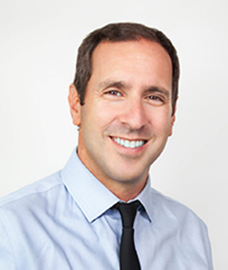
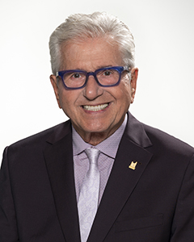
Your Local Municipal Councillors
Toronto-St. Paul’s
Councillor Josh Matlow
Eglinton-Lawrence
Councillor Mike Colle
Toronto City Hall
100 Queen Street West, Suite A17
Toronto, ON M5H 2N2
Telephone: 416-392-7906
Email: councillor_matlow@toronto.ca
Toronto City Hall
100 Queen Street West, Suite A20
Toronto, ON M5H 2N2
Telephone: 416-338-2500
Email: councillor_colle8@toronto.ca
Constituency Office
2952 Dufferin St.
Toronto, ON M6B 3S9
Telephone: 416-338-0008
Councillor Matlow Website
https://joshmatlow.ca/
Notes:
We work together on behalf of our communities.

Slide 6
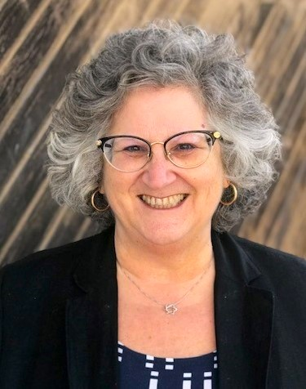
Your Local Trustee
Serving my sixth term as trustee on the TDSB where I am a member of the Finance, Budget & Enrolment Committee and Chair the Audit Committee.
Elected to the Board of Directors of the Toronto Lands Corporation
Proud of my involvement championing ground-breaking policies on parent and community involvement, equity, EcoSchools, healthy schools, open data and documenting incidents of hate, among others.
Chair of OPSBA’s Policy Development Working Group.
Bachelor of Arts degree and a graduate diploma in Cartography, blends planning and action.
Since 2004, I am a Senior Advisor within the Ontario Public Service, where I currently support governance within provincial agencies.
Ward 8
Eglinton - Lawrence & Toronto-St. Paul’s
416-395-8787 | Shelley.Laskin@tdsb.on.ca
Twitter @shelleylaskin | www.tdsb.on.ca/Ward8

Slide 7
We Are the TDSB
The Toronto District School Board (TDSB) is the largest and one of the most diverse school boards in Canada.
The Toronto District School Board (TDSB) is the largest and one of the most diverse school boards in Canada. We serve approximately 238,000 students in 582 schools throughout Toronto, and more than 100,000 life-long learners in our Adult and Continuing Education programs.
Annual operating budget is approximately $3.5B;
Provincial Grants $2.9B and other Revenues $0.5B.
TDSB has 16,030 permanent & 5,260 occasional teachers & 15,500 permanent support staff & 4600 supply/casual employees.

Slide 8
Who are the people in a school board?
Parents & Caregivers
Students (YOU!)
Trustees
Central Staff
Teachers
Director of Education
Education Workers
Supervisory Officers
(Superintendents)
Principals & Vice-Principals
Notes:
Trustees play a key leadership role in ensuring that schools operate within the standards established by the province, and that the programs and services remain responsive to the communities they serve. Generations of community-minded citizens have made decisions on behalf of local, publicly funded schools, building the foundation of the system we have today. School board trustees are communicators, problem solvers and most importantly, advocates for public education.
The Director of Education is the chief executive officer and chief education officer of the school board. The director is the sole employee who reports directly to the board and acts as secretary of the board.
Supervisory Officers, often called superintendents, are accountable to the director of education for the implementation, operation, and supervision of educational programs in their schools.
Principals are the educational leaders within their school communities and ensure that the programs that are in place are effective and align with board and ministry policies.
Teachers are the front-line representatives of the education system. Their many activities go beyond instruction and include encouraging students to pursue learning, maintaining classroom discipline, and evaluating students’ learning and progress.
Education Workers include a whole range of people that support students and keep a safe and healthy school environment. Educational Assistants, Early Childhood Educators, Caretakers, School Secretaries, Social Workers, and Speech and Language Pathologists are just some of these.
Parents/Caregivers are critical in the support they provide in the overall education of our students.
Students are the most important stakeholders in our system.

Slide 9
Trustees...
School board trustees are the oldest form of elected representation in Ontario.
The office has been in existence since 1807 and represents citizens in the education decision-making process.
The election of school board trustees is governed by the Education Act and the Municipal Elections Act, 1996. Both are the laws or rules that trustees follow.
Every 4 years, 22 public school Trustees are elected during municipal elections to represent public school supporters in the City of Toronto. They are locally-elected representatives of the public, and they are the community’s advocates for public education and members of the Board.
19 Trustees represent one of our 25 wards; 3 represent two wards. Each ward is a diverse community with unique needs, priorities and educational requirements and Trustees represent their communities.
The TDSB also has 2 students trustees appointed through the Student Senate and an Indigenous Trustee appointed through the Indigenous Council.
Notes:
School board trustees are members of a district school board. They are locally-elected representatives of the public, and they are the community’s advocates for public education.
School board trustees are the oldest form of elected representation in Ontario. Since 1807, generations of community-minded citizens have made decisions on behalf of local, publicly funded schools, building the foundation of the system we have today.
The election of school board trustees is governed by the Education Act and the Municipal Elections Act, 1996. Both are the laws or rules that trustees follow.
Additional information about Ontario’s Public Education System:
Preparing students to become productive and contributing citizens is the foundation of a civil society.
Ontario’s English public district school boards provide universally accessible education for all students, regardless of their ethnic, racial, or cultural backgrounds; social or economic status; gender; individual exceptionality; or religious preference.
The English public system is founded on the principle of equity of educational opportunity: every student deserves an opportunity to achieve to his or her fullest potential.
Public school boards provide high standards in their programs and ensure that there are supports and resources to help all students reach those standards.
Public school boards also focus on character education to ensure that students develop as caring and responsible members of their community and of Canadian society as a whole.
Character education embraces values such as Citizenship, Cooperation, Courage, Empathy, Fairness, Honesty, Humility, Inclusiveness, Initiative, Integrity, Kindness, Optimism, Perseverance, Resilience, Respect, and Responsibility.
English public district school boards, in partnership with parents and caregivers, prepare students for success in whatever field they choose.

Slide 10
Trustee Committees
TDSB Trustees meet at least nine times during the year for regular meetings of all trustees. There are also three standing committees and one permanent committee that meet and present reports at the regular Board meetings.
Board and committee meetings are live broadcast.
Members of the public are invited to bring forward issues and concerns to the appropriate standing committee through the delegation process.
The delegation procedure helps manage this process and ensures a fair and equal forum.

Slide 11
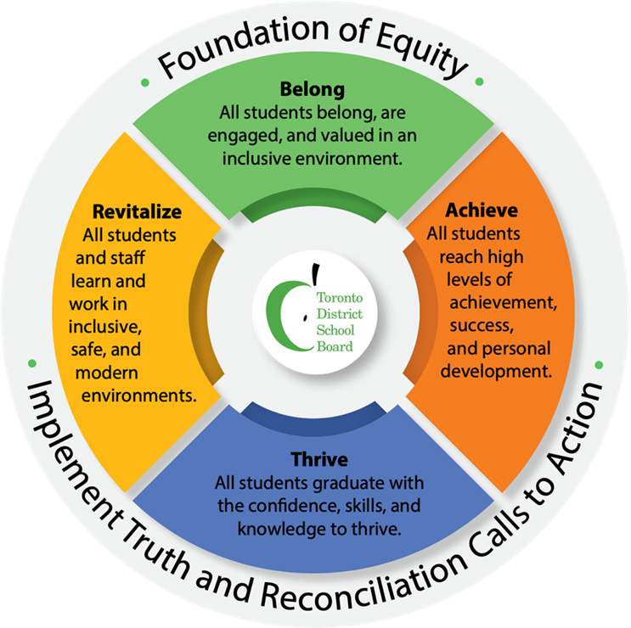
Multi-Year Strategic Plan
Mission –
To enable all students to reach high levels of achievement and well-being and to acquire the knowledge, skills and values they need to become responsible, contributing members of a democratic and sustainable society.
Notes:
TDSB Trustees have recently renewed their Multi-year Strategic Plan - The Strategic Directions within the MYSP is our continued journey towards excellence in education for all students.
The MYSP is the culmination of a year and a half of planning and broad consultation with the TDSB community and provides a coherent direction for staff that aligns with the Ministry of Education Student Achievement Plan (SAP) to ensure coherence, clarity, and effective use of resources.
With Equity as a guiding principle, and a commitment to Truth and Reconciliation: Calls to Action, the MYSP will guide and focus our work for the next four years (2024-28). The MYSP serves as a roadmap towards realizing the collective vision for the students and staff served by the TDSB and is a reflection of the rich perspectives, ideas, and goals of TDSB communities.
This MYSP is built on the important and relevant themes of Belong - Achieve - Thrive - Revitalize.
We want every student to feel they belong, have what they need to achieve and thrive in our programs, schools, the City of Toronto, and the world.
A key component of fulfilling those directions is a revitalization of the processes which support 40,000 staff in addition to creating new and renovating existing schools and work sites. It is an important complementary strategic direction to those directly focused on our students. Equity must be woven throughout our actions to create greater belonging, achievement, and the conditions where EVERY student can thrive.
This renewed MYSP 2024-2028 reflects:
● The Board’s ongoing commitment to equity
● Input from students, parents/guardians/caregivers, staff, community partners, and education partners through the engagement process
● Input from the TDSB Board of Trustees and senior leadership
● The 2022 board resolution committing to including the implementation of the Truth and Reconciliation Commission of Canada: Calls to Action in the Board’s strategic directions
● The Ministry of Education’s Provincial Priorities in Education, Student Achievement Plan and required indicators
● Effective practices learned from the jurisdictional scan, system data and evidence illustrating trends of respect, compassion, citizenship, well-being, and belonging

Slide 12
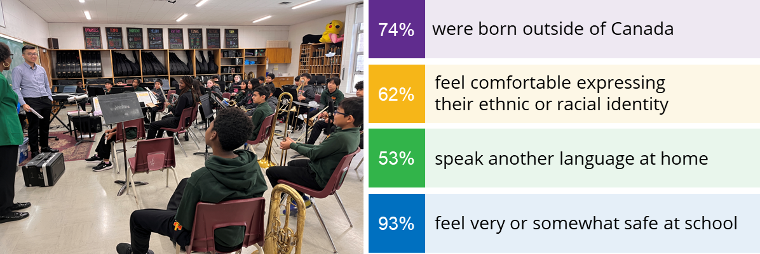
Student Census Results
Notes:
The Toronto District School Board (TDSB) Student Census was conducted in the spring of 2023 (April to June). It is a confidential and voluntary survey that asks important questions about students’ school experiences and identities. The Student Census, conducted every five years since 2006, allows school communities to determine what is working well, where change is required, and where support should be focused to improve school environments and help every student succeed. The Census team spent over a year conducting 60+ community consultations to inform the development of the Student Census with students, staff, families, and community members - both within and outside the TDSB.
In total, 138,240 TDSB students (Grade 4 to 12) and parents/guardians/caregivers of Junior Kindergarten (JK) to Grade 3 participated in the Census. This was an overall response rate of 58%. Based on analysis of TDSB grade proportions, student geographic proportions, and proportions of socioeconomic status, a 58% response rate is a strong representation of the student population.
Since 2006, TDSB schools have been collecting identity-based data through the Student Census to identify and remove systemic barriers which may limit student achievement and well-being. The Ontario Human Rights Code permits the collection and analysis of data based on grounds such as race, disability or gender as long as it is for legitimate purposes (e.g. identifying and removing systemic barriers, preventing disadvantage or promoting substantive equality) and not contrary to the Code.
Since 2018, under the Provincial Anti-Racism Act, school boards have been encouraged to collect identity-based data, including Indigenous identity, ethnic origin, race and religion. As of January 2023, identity-based data collection is now mandated for school boards. The TDSB was the first school board to do so.
Specifically related to gender, understanding gender diversity for students is part of a school's responsibility in creating accepting and positive school climates. In 2012, the Ontario Human Rights Code (Toby's Act Bill 31) incorporated gender identity and expression as fundamental legal human rights for every citizen - ensuring that one's 'lived gender identity' is one's legal gender identity.
At the same time, in 2012 the Education Act (Bill 13 Accepting Schools Act) incorporated all areas protected under the human rights code including gender identity and gender expression and made explicit that all boards must ensure safe, inclusive and positive school climates accepting of all students.

Slide 13
So, what do trustees do?
We’re here to support you and bring the concerns of students, parents and community to the attention of the board.
Notes:
This is an overview that you can refer to:
Attend and participate in meetings of the board, including meetings of board committees
Consult with parents, students and supporters of the board on the board’s multi-year plan
Bring concerns of parents, students and supporters of the board to the attention of the board
Uphold the implementation of any board resolution after it is passed by the board
Entrust the day–to-day management of the board to its staff through the board’s director of education
Maintain focus on student achievement and well-being
Comply with the board’s code of conduct.

Slide 14
We Believe in Community
The TDSB engages with organizations from many sectors to enhance student success, professional learning and the educational environment.
Our partners include community organizations, post-secondary institutions, businesses, charitable foundations, health agencies, arts organizations and social service agencies.
These working relationships with external agencies are considered either educational, business and/or facilities arrangements.
Educational Partnership Office www.tdsb.on.ca/partnership

Slide 15
Student achievement and well-being.
Ensuring effective stewardship of the board’s resources.
Delivering effective and appropriate education programs for their students.
Notes:
School boards – the elected board of trustees – are responsible for student achievement and well-being, for ensuring effective stewardship of the board’s resources and for delivering effective and appropriate education programs for their students.
The Education Act and its regulations set out the services that district school boards and school authorities must offer. The responsibilities of a school board include a key governance role with respect to:
operating schools according to provincial legislation
having a vision statement that reflects the board’s philosophy and local needs and priorities
setting the board’s budget within the provincial grants and accompanying regulations
implementing curriculum according to ministry curriculum policy
developing and delivering other programs that reflect provincial policies and local priorities
providing for the hiring of teachers and other staff required in their schools
maintaining school buildings and property regarding student safety and in accordance with provincial legislation
monitoring the policies of the schools and the achievement of students and, through the director of education, holding the entire system accountable for meeting provincial and board standards.

Slide 16
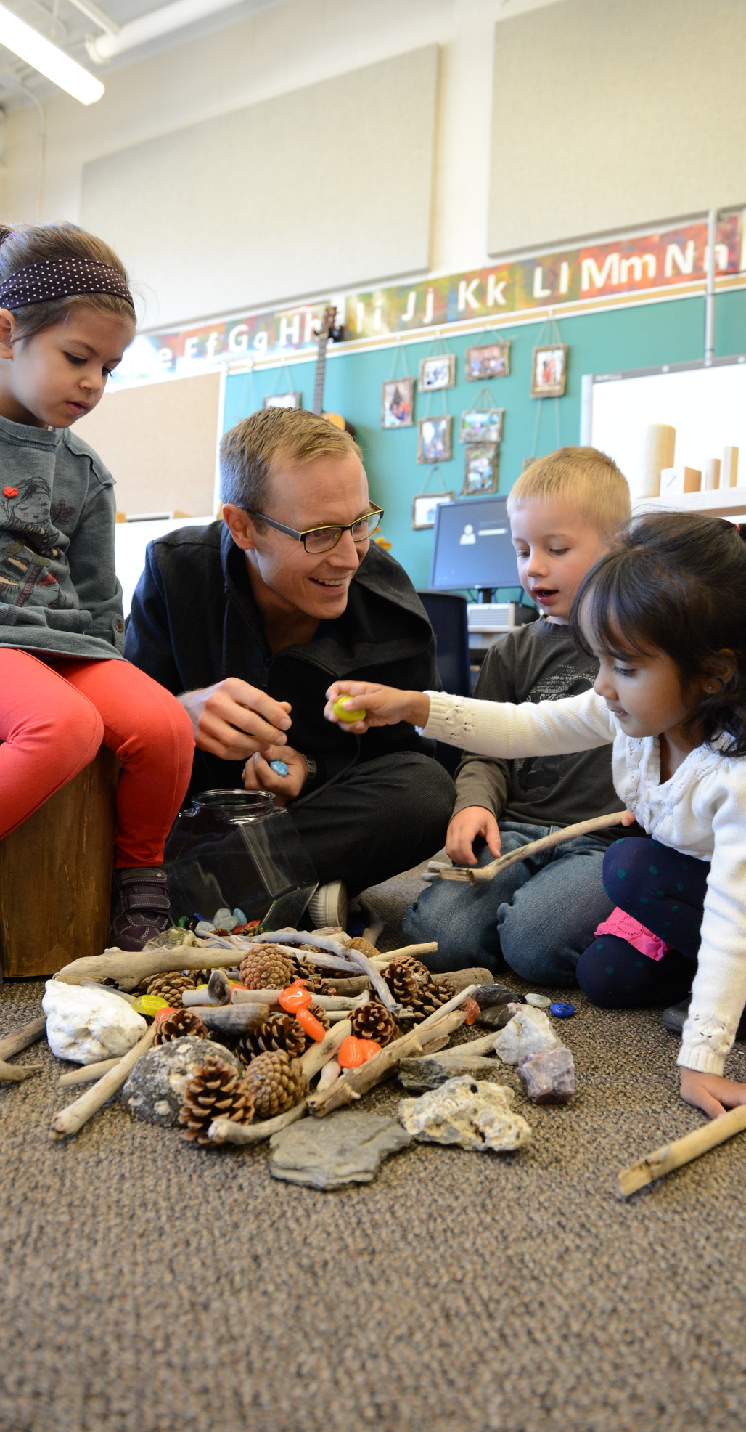
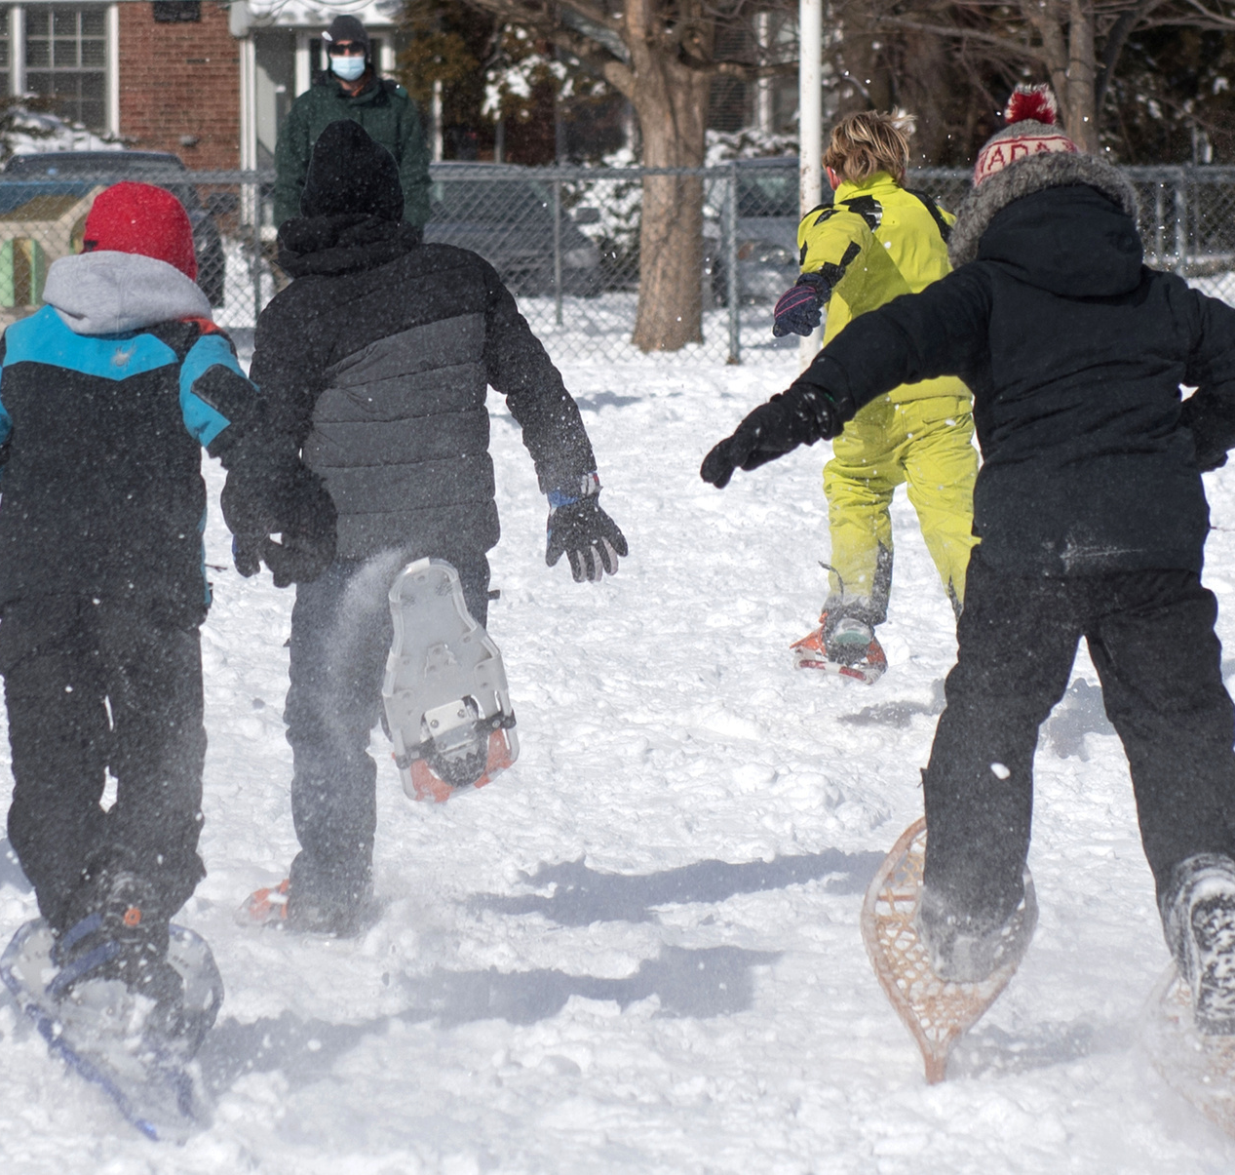
What do you think are some issues related to education?
Notes:
Discussion Slide 1

Slide 17
Are any of these education-related issues important to you?
Capital
Special Education
Child-care
Indigenous Education
Children and Youth Mental Health
Student Achievement
Equity, Diversity, and Inclusion
Well-being
Facilities
Transportation
Healthy Schools
Technology
Notes:
Discussion Slide 2

Slide 18
Let’s discuss! What would you like trustees to know about these education-related issues in your classrooms?
Capital
Special Education
Child-care
Indigenous Education
Children and Youth Mental Health
Student Achievement
Equity, Diversity, and Inclusion
Well-being
Facilities
Transportation
Healthy Schools
Technology
Notes:
Discussion Slide 3

Slide 21
Thank You
About OPSBA
Our board is a member of the Ontario Public School Boards’ Association (OPSBA), which represents 31 English public district school boards and 10 public school authorities across Ontario.
OPSBA’s members serve the educational needs of nearly 1.4 million elementary and secondary students. The Association, based in Toronto, advocates to the provincial government on behalf of the best interests and needs of the public school system in Ontario.
Notes:
More information at www.opsba.org

