Slide 1


Jewish Heritage Committee
Update May 2024
\

Slide 2


District School Board
Toronto District School Board Jewish Heritage Committee
May is Jewish Heritage Month
The Canadian Jewish Heritage Act, which was passed in May 2018, is also recognized by the Province of Ontario by the passing of the Jewish Heritage Month Act, 2012.
As stated in the Act, “May is a significant month for the Jewish Canadian community. Israeli Independence Day (Yom ha-Atzmaut) and Holocaust Remembrance Day (Yom ha-Shoah) frequently occur in May, as do various Jewish artistic and cultural events.”
Heritage Months help us understand one another by showcasing different cultures and communities to be celebrated. Understanding and appreciating the contribution different communities make to Canada brings us close together.

Slide 3

Toronto District School Board
Toronto District School Board Jewish Heritage Committee
Who Are We?
Jews are an ethnic and national people who identify as a distinct group with our own religion, history, traditions, and story.
0.2% of the 8B worldwide population
1.4% of Canada
3.5% of Toronto
3.5% of TDSB students

Slide 4
Toronto District School Board
Toronto District School Board Jewish Heritage Committee
TDSB Jewish Heritage Committee
Since its inception in 2015, the TDSB’s Jewish Heritage Committee (JHC) of nearly 350 staff across every level of the system as well as Trustees, has focused on teaching & learning in classrooms, with students.
We aim to celebrate Jewish heritage and culture in impactful, innovative, and inspirational ways, with the fight against antisemitism and all forms of hate providing the core goal of this work.
We provide programming throughout the school year including Jewish Heritage Month in May.

Slide 5
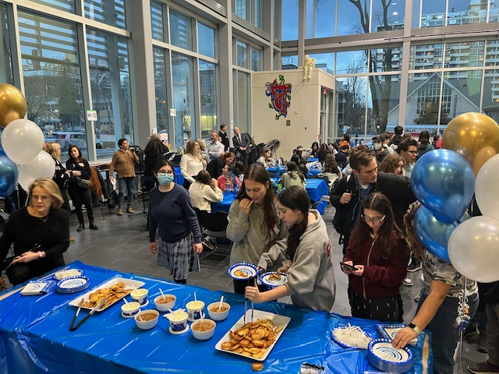
District School Board
Toronto District School Board Jewish Heritage Committee
Bringing Jewish Students Together
In December, the JHC hosted a Hanukkah Party that brought together Jewish Student Groups from 16 of our high schools.
We believe this is the start of an important network of Jewish student groups at our high schools (many of whom already have Jewish student associations/Jewish culture clubs/Jewish student alliances) who can inspire and support each other.

Slide 6

District School Board
Toronto District School Board Jewish Heritage Committee
Bringing Jewish Staff Together
In December, the JHC also hosted a Hanukkah Party that brought together Jewish Staff.
Staff enjoyed the opportunity to reconnect and make new relationships.

Slide 7

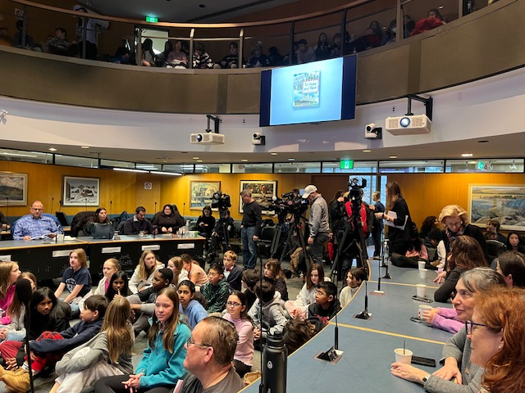
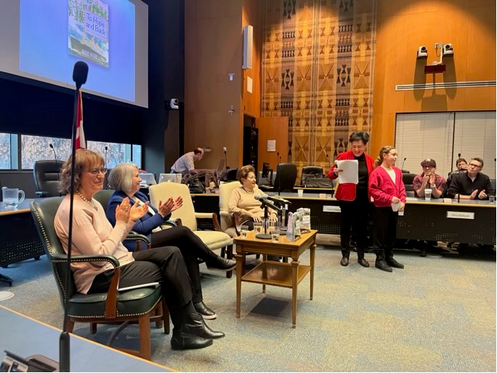
Toronto District School Board
Toronto District School Board Jewish Heritage Committee
International Holocaust Remembrance Day
The JHC sponsored a “One Book Event” for Grade 6 students to commemorate International Holocaust Remembrance Day.

Slide 8

Toronto District School Board Jewish Heritage Committee
Curriculum Supports
The live-streamed event from the TDSB Boardroom “To Hope and Back” was the launch of a comprehensive Holocaust education program for Grade 6 students, in line with the new Social Studies curriculum.
This non-fiction book by well-known children’s author Kathy Kacer tells the story of the MS St. Louis, an ocean liner carrying over 900 Jews fleeing Nazi-occupied Europe that was turned away from every port, including Canada’s. TDSB’s staff created lessons and resource material to support the event.

Slide 9
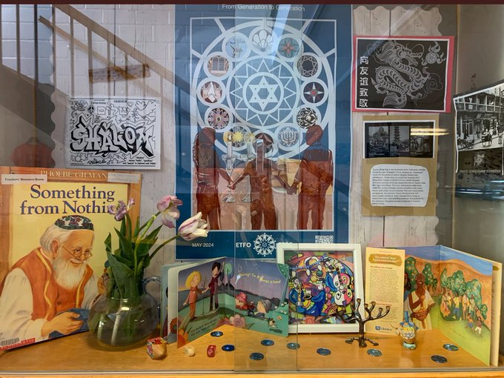
Toronto District School Board
Toronto District School Board Jewish Heritage Committee
Jewish Heritage Month
As with other TDSB Heritage Months, local schools determine how to acknowledge.
We are grateful to the many schools who housed displays, made announcements, did assemblies and made space for rich discussion about Jewish Heritage and Culture.

Slide 10

Toronto District School Board
Toronto District School Board Jewish Heritage Committee
Yom HaShoah
Yom HaShoah or Holocaust Remembrance Day on May 6, specifically commemorates the six million Jews murdered in the Holocaust, and the heroism of survivors and rescuers.
The TDSB was pleased to once again partner with Liberation 75
to offer a Student Education Day
on Yom HaShoah – incredible programming for students from grades 4-12.

Slide 11
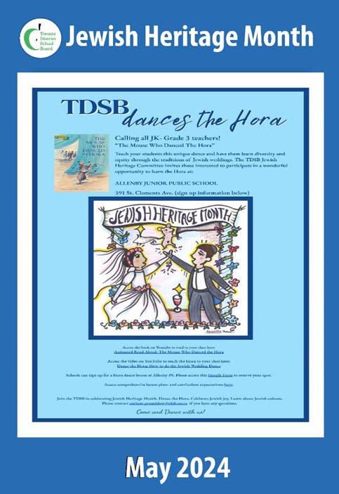
Toronto District School Board
Toronto District School Board Jewish Heritage Committee
Jewish Heritage Month –
The Mouse Who Danced The Hora
As in previous years, the JHC’s commitment is to plan annual educational opportunities and enrich the curriculum for further learning about Jewish heritage and culture.
Each year we choose one grade or division to focus on and provide programming. This year, we are focussing on students in Kindergarten to Grade 3. We are using the book The Mouse Who Danced the Hora, to teach our youngest students about diversity and equity through Jewish wedding traditions.

Slide 12

Toronto District School Board
Toronto District School Board Jewish Heritage Committee
Dancing the Hora!

Slide 13

Toronto District School Board
Toronto District School Board Jewish Heritage Committee
Making Challah
The braided challah, which is made with eggs, is the Jewish Sabbath and holiday bread.

Slide 14
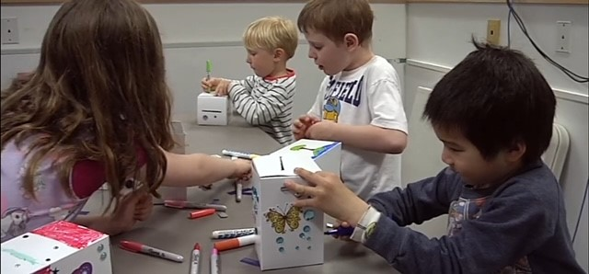
Toronto District School Board
Toronto District School Board Jewish Heritage Committee
Making Tzedakah Boxes
“Tzedakah” literally means righteousness.
To do tzedakah is to live justly.

Slide 15
District School Board
Toronto District School Board Jewish Heritage Committee
Educating Against Hate
From October to December 2023, Toronto police reported Antisemitic incidents were up 211 per cent compared to the same time period last year. Antisemitism made up 53 per cent of all reported hate crimes during that period.¹
Data mirrors TDSB’s hate statistics as reported in March where Jewish students make up approximately 3.5% of the population but the proportion of incidents that involved antisemitism from October to December 2023 increased by 5 percentage points from 10 to 15%, as compared to the same period last year – the highest reported hate by creed.
The JHC supports the efforts of our Equity and Human Rights Office in educating against hate.
¹https://www.cbc.ca/news/canada/toronto/hate-crimes-data-toronto-police-1.7064086

Slide 16
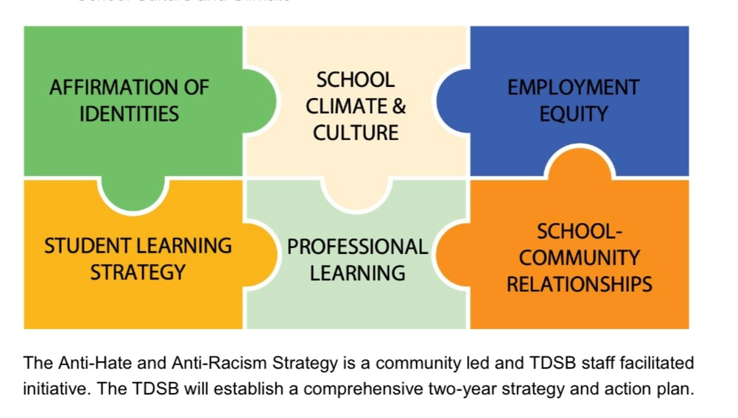
Toronto District School Board
Toronto District School Board Jewish Heritage Committee
Combatting Hate and Racism
The TDSB aims to be responsive to the voices of communities by developing tailored action plans each based on the pillars of the Anti-Hate and Anti-Racism Strategy.
The JHC is pleased to be involved in the creation of the Antisemitism Strategy.

