Slide 1
École virtuelle TDSB
Grades 5-6 Core French
Jeudi le 24 septembre 2020

Slide 2
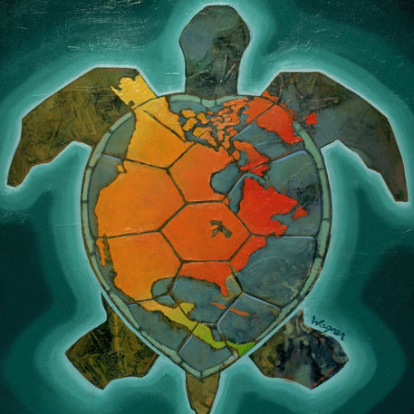
Texte reconnaissant de traités
Nous reconnaissons que nous sommes accueillis sur les terres des Mississaugas des Anichinabés, de la Confédération Haudenosaunee et du Wendat. Nous voulons également reconnaître la pérennité de la présence des Premières Nations, du Métis et du Inuit.
‹#›

Slide 3
Offers free French-language educational videos, digital books, apps and games to engage K-12 children in their second language learning
Subtitles available (use of French subtitles is suggested)
How to create an Idello account (parents and students)
IDÉLLO : Video Tutorial for Parents & Students on how to create an account
In order to access some resources that you will be using in class, it will be useful to have an account with Idello. If you don’t already have one, please take some time to set one up with the help of an adult.
Regarde la prochaine page.

Slide 4
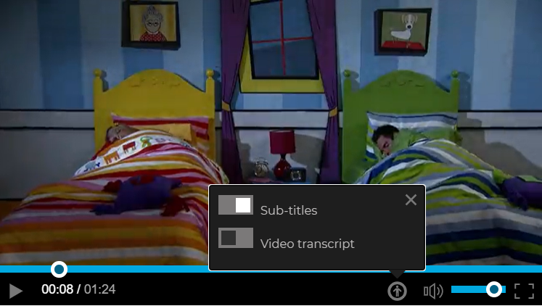
French subtitles
It’s a good idea to play the French subtitles while you watch a video. You might recognize some words and you can make a connection between the sounds and the words.
To turn on the subtitles, start a video. Then, click on the button and then click on “Sub-titles” like you see in this screenshot.

Slide 5
Please note...
For all documents, students can make their own copy so they may type and edit directly in their copy. Students may also choose to use a piece of paper and record their work if they prefer.
Merci!
Regarde la prochaine page.

Slide 6
Bonjour!
Bonjour! Bienvenue à la classe de français Cadre!
Today is the jeudi, and it is the 3rd day of Core French (“le français cadre”) in the TDSB Virtual School.
Do you remember what you learned yesterday? Take a moment to reflect.
Today you will review some of the things you learned in grade(s) 4/5 (the days of the week, the months of the year and numbers). You can find all of this in Dictionnaire de base as well.
Regarde la prochaine page.

Slide 7
Les jours de la semaine
Voici les jours de la semaine
Bonjour! Aujourd'hui c'est
jeudi le 24 septembre 2020
Do you remember how to say the days of the week in French?
Earlier this week, you heard a song by Alain le lait called “Bonjour, bonjour”.
Listen to this song to help you review the days of the week!
Écoute la chanson “Les jours de la semaine” de Alain le lait.
Chante! Sing along!
lundi
mardi
mercredi
jeudi
vendredi
samedi
dimanche

Slide 8
Les mois de l’année
Voici les mois de l'année
Bon travail! Keep practicing “Les jours de la semaine”!
Aujourd'hui Alain le lait will help you review the months of the year!
Écoute la chanson “Les mois de l’année” de Alain le lait.
Chante! Sing along!
janvier
juillet
février
août
mars
septembre
avril
octobre
mai
novembre
juin
décembre

Slide 9
Les nombres #
Voici les nombres # de 1 à 30
un | deux | trois | quatre | cinq
six | sept | huit | neuf | dix
onze | douze | treize | quatorze | quinze
seize | dix-sept | dix-huit | dix-neuf | vingt
vingt-et-un | vingt-deux | vingt-trois | vingt-quatre | vingt-cinq
vingt-six | vingt-sept | vingt-huit | vingt-neuf | trente
You probably already know numbers in French but practice with numbers in French will help you with math as well as to answer questions related to the important dates and events in your life
Peux tu compter jusqu'à 100?
Plus?
Watch this Idello video Nombres de 10 à 69

Slide 10
Mon anniversaire
Quand est ton anniversaire?
Exemple: Mon anniversaire, c’est le 25 novembre.
Practice saying when your birthday is.
Mon anniversaire, c’est le _____ ______________.
# mois
Do you celebrate ton anniversaire? If so, how do you celebrate?

Slide 11
Réponds à ces questions!
Try to answer the questions to see what you remember
Quelle est la date aujourd’hui?
Quel âge as-tu?
Quand est ton anniversaire?

Slide 12
Do you still remember “Comment t’appelles-tu?” and “Quel est ton nom?”
Now practice answering the questions using one of the different ways in the box below (you can do this orally or you can write your answers on a piece of paper or a Google doc)
Je m’appelle _________.
Mon nom est __________.
Je suis ____________.
Do you know what your name means?
Is there a story behind your name?
What do you think about your name?
Make a visual representation of what your name means to you, such as a drawing, or loose parts.

Slide 13
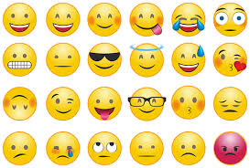
À la tâche!
Create your own emoji! How might you represent yourself in a creative way? You might choose to make it look like you, or you could create an avatar (a digital representation of yourself.)
Écris ton nom et ton anniversaire aussi.

Slide 14
Bravo! À bientôt!

