Slide 1
École virtuelle TDSB
5e année français intensif
mardi le 22 septembre 2020

Slide 2
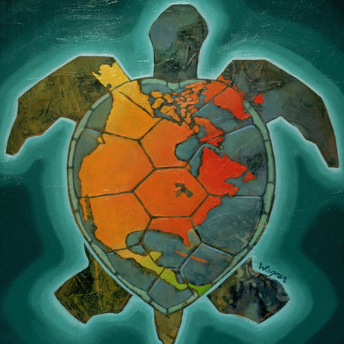
Texte reconnaissant de traités
Nous reconnaissons que nous sommes accueillis sur les terres des Mississaugas des Anichinabés, de la Confédération Haudenosaunee et du Wendat. Nous voulons également reconnaître la pérennité de la présence des Premières Nations, du Métis et du Inuit.
‹#›

Slide 3
Le français
Bonjour! Bienvenue à la classe de 5e année français intensif! We are so happy that you are here.
Écoute la chanson “Bonjour, bonjour” de Alain le lait. C’est un peu drôle! Tu peux chanter aussi, si tu veux!
Regarde la prochaine page.

Slide 4
Comment ça va?
Prends une minute pour penser à tes émotions aujourd’hui, le premier jour de 5e année en français intensif dans l’école virtuelle du TDSB.
Es-tu excité/excitée? Es-tu nerveux/nerveuse? Peut-être que tu as des émotions différentes?
Est-ce que tu te souviens de ce que tu as fait en français en 4e année?
Regarde la prochaine page.

Slide 5
Les émotions
Écoute. Comment ça va? Pick the emotions that you feel
today and practice saying them out loud. Remember that
there are different ways to say the word depending on if you
identify as a boy or a girl.
Je suis content / contente.
Je suis nerveux / nerveuse.
Je suis curieux / curieuse.
Je suis fâché / fâchée.
Je suis fatigué / fatiguée.
Je suis excité / excitée.
Ça va comme ci, comme ça.
Je suis confus / confuse.

Slide 6
C’est moi!
Nous allons pratiquer à se présenter un peu...en français!
Clique pour ouvrir le document C’est moi!.
Complète l’activité. Tu peux utiliser un papier ou un Google Doc pour écrire tes idées.
Explore et joue à un jeu sur le site Radio-Canada Jeunesse. Amuse-toi en jouant en français!

Slide 7
Math - Getting into a Math Mindset!
What is a mathematician?
A person who uses math to solve problems
Who can be a mathematician?
We are all mathematicians! We can all “do math”. We all use math in our daily lives in so many ways. We all have different feelings about math but we are all capable. We can all choose different strategies that work for us and work through problems. We can get help if we need it.

Slide 8
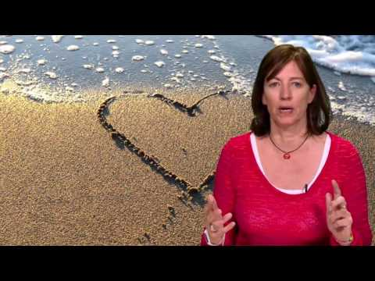
Watch the video. Focus on identifying the main ideas.
What is the key message?
What do you notice?
What do you wonder?
Take a moment to reflect about these questions. You may jot down some notes on a paper or in a Google Doc if you wish.
https://www.youcubed.org/resources/mindset-video/

Slide 9
Thinking about your Math Mindset
It is important for us to get into a positive mindset for learning math and remember that we are all capable. We need to develop helpful habits and positive self-talk (for example, the messages we tell ourself when we are doing a challenging problem).
Complete the following Math Mindset Reflection Activity to help you reflect about your feelings about math.

Slide 10
Noticing Math All Around Us
Math is everywhere! In our homes, in the community, in nature…
How do you use math in your everyday life? (examples: at home, at school, in other places you go)
How does math help you in your everyday life?
How does math help others in our community and around the world?
Reflect and record your ideas on this document.

Slide 11
Setting a Math Goal
What would you like to accomplish this year related to math?
For example:
Is there a challenge you want to overcome?
Is there something new you want to learn?
Is there something you want to get better at?
Is there a new habit you want to form that will help you with math?
?

Slide 12
Choose one goal for yourself (or more if you’d like).
Make a written, visual or audio representation of this goal, such as drawing a picture, using loose parts (found materials around you) and taking a photo, making a poster, a Google Drawing, making a voice recording, or another format of your choice. Include your goal with your representation.
How will you work to achieve this goal? Can you identify some steps you will take to be successful? (“a plan of action”)
Refer back to your goal and your visual representation regularly as well as your plan of action to see how you are doing and adjust your plan if needed. It’s a work in progress!

Slide 13
Bravo! À bientôt!

