Slide 1
FSLCAC
French as a Second Language
Community Advisory Committee
Toronto District School Board
(TDSB)
2023 12 15

Slide 2

FSLCAC is a TDSB Advisory Committee
The FSLAC is one of 10 TDSB community advisory committees.
TDSB advisory committees:
-facilitate parental and community input and information sharing
-have the opportunity to advise the TDSB on its on its policies, procedures and programs

Slide 3

FSLCAC Mission
To consult with and advise the Board on French as a Second Language matters. As a Board community advisory committee, the FSLAC will contribute to the work of trustees and staff. This partnership of trustees, staff and parents will foster excellence and growth in FSL programs at the board.
The FSLAC mission was adopted by the TDSB on January 27, 2007, and
reaffirmed on May 25, 2016.

Slide 4
FSLCAC Membership
        Trustee Co-Chair
        Parent Co-Chair
        Parent Vice Co-Chair(s)
        Ward Representatives (Parents)
        Ward Alternate Representatives (Parents)
        Canadian Parents for French Representative (Community)
        TDSB FSL Program Staff
        TDSB Committee Assistant
Ward representatives are voting members, 1 vote per ward represented.
Everyone in the community is welcome to attend.

Slide 5
TDSB FSL Programs
TDSB French as a Second (Official) Language programs:
        Core French (grade 4 start)
        Early French Immersion (JK start)
        Middle French Immersion (grade 4 start)
All TDSB French programs are designed for students and families who do not have French as a home language.
There is no need for parents to know or understand French in order for their children to participate in Core or Immersion programs.

Slide 6
FSL Benefits
Research shows that:
second-language learning provides significant cognitive and academic benefits,
learning another language can help in the development of interpersonal and social skills,
English-French bilingualism is an economic and cultural asset both within Canada and beyond.
A Framework for French as a Second Language, Ministry of Education (2013) http://www.edu.gov.on.ca/eng/amenagement/frameworkFLS.pdf

Slide 7

Excellence and Inclusion
TDSB Policy 080 French as a Second Language Programs
The Board recognizes that:
      4.1 French is one of Canada’s two official languages and it is a language used widely around the world;
      4.2 Proficiency in French is a valuable skill and an element of student achievement;
      4.3 Teaching and learning French-as-a-Second Language strengthens English language skills, enhances reasoning, problem-solving and creative thinking skills and develops understanding and respect of other cultures.
The Board is committed to:
      4.4 Providing quality programs which develop student proficiency in French;
      4.7 Core/Immersion French programs that include English language learners and students with special education needs and are inclusive and reflective of a diverse community.

Slide 8
Core French Total Enrolment 2022-2023
Source: Annual Enrolment Report PSSC Oct 18, 2023
Note: For students not in Immersion/Extended French, Core French is mandatory from Grade 4-8. In secondary, all students do at least one credit in French.

Slide 9
Extended and Immersion French Total Enrolment 2000-2023
28,013
29,822
27,480
24,843
21,448
Source: Annual Enrolment Report, PSSC Oct 18, 2023
Note: Extended French is being phased out.

Slide 10
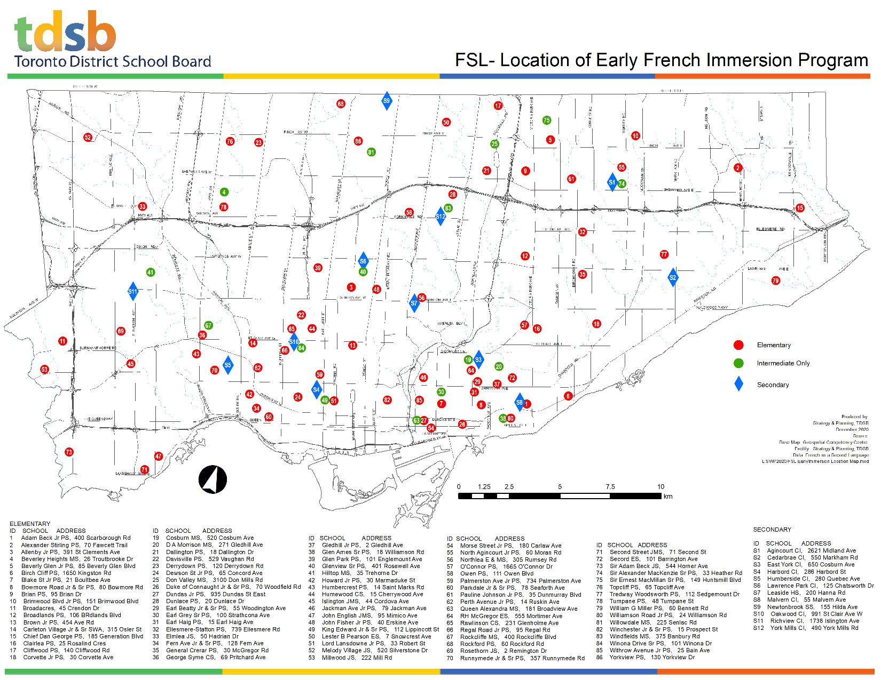
Early French Immersion Locations 2023-2024

Slide 11
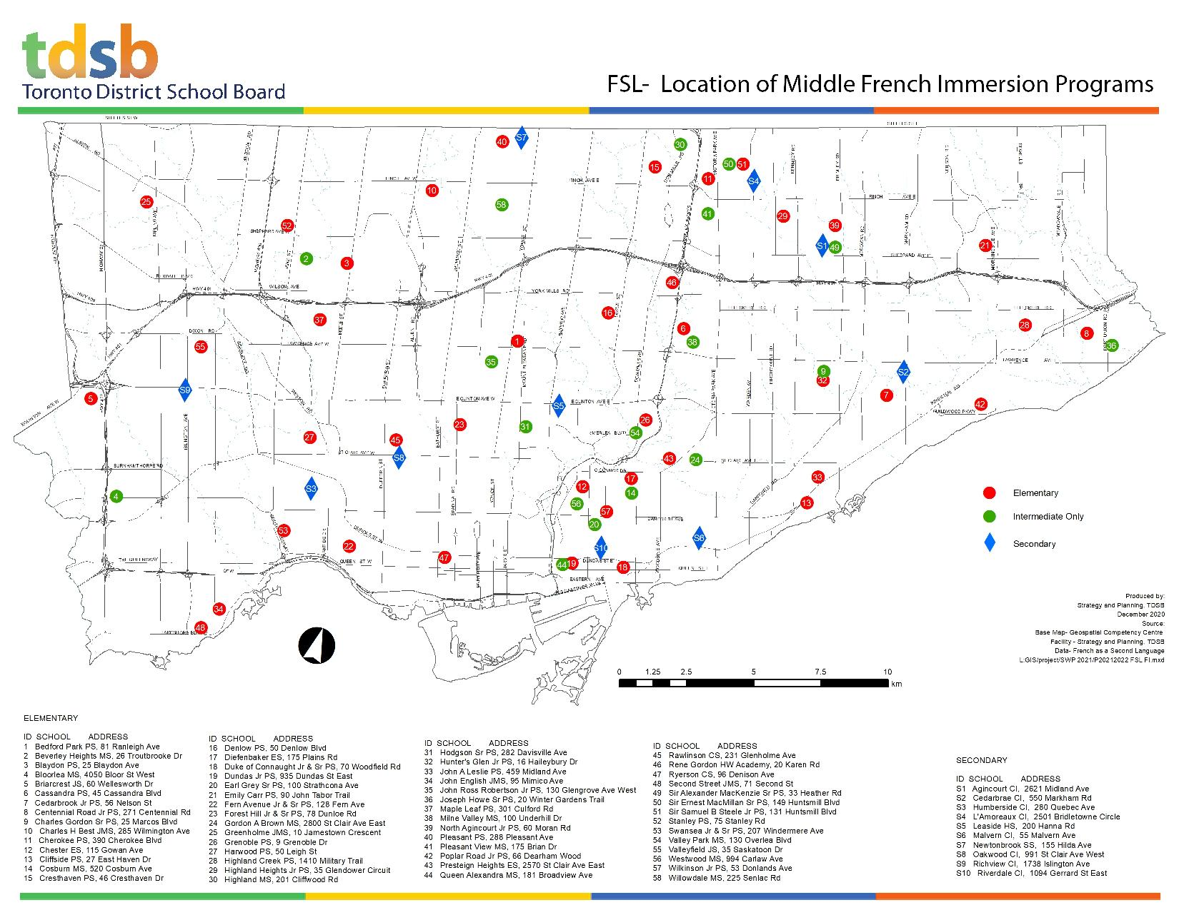
Middle French Immersion Program Locations 2023-2024

Slide 12

FSLCAC Activities
Provide FSL Parent-to-Parent support
    (i.e. gmail, newsletter, parent conferences)
Meet 7-8 times per year, all welcome
Appear and depute at various Board committee meetings
Meet regularly with FSL program staff

Slide 13

More FSLCAC Information
Visit us: www.tdsb.on.ca/fslcac
Sign up:
E-newsletters (3/year) for tips and community information Occasional news blast for time sensitive information
Join Us:
meeting information posted at www.tdsb.on.ca/fslcac
Email Us:
fslactoronto@gmail.com

